Slide 1

Engineering Codex
Caching Strategies
d
g
x

Slide 2
Improving Availability of Data
Enabled Horizontal Scaling
Minimizing Network Latency
Improved User Experience
Resource Optimization
Decreased API Rate Limiting
How Caching Improves Performance

Slide 3
Caching is only necessary if your cost to access or availability requirements are incompatible with your underlying data source

Slide 4
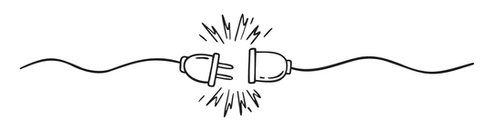
Cache Extension Points

Slide 5
Client
Edge Network
Gateway /Web Server
Origin Servers
Data Source
client-side caching
edge
caching
response
caching
local application caching
distributed application
caching
data-side
caching
Where to Cache

Slide 6
ADOPT
we think you should seriously consider using this.
TRAIL
we think are ready for use, but not as completely proven
ASSESS
Things to look at closely, but not necessarily trial yet — unless you think they would be a particularly good fit for you.
HOLD
Proceed with caution.
GDX Tech RADAR

Slide 7
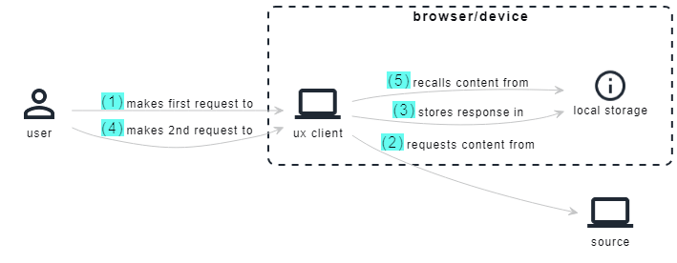
Client Side Caching
ADOPT
Utilize storage on client devices to fetch assets that are frequently reused, and store them locally for fast future recall.
Use Cases
Static assets
nonvolatile API responses
API responses where content mutation is controlled by the client

Slide 8
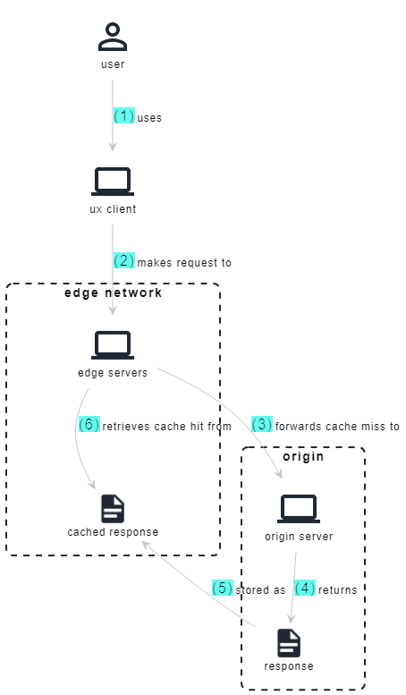
Edge Caching
ADOPT
Utilize edge networks to cache compiled content from an origin closer to end user clients
Use Cases
Internet facing resources only
Frequently accessed resources
Content that is resource intensive to generate
Content where we anticipate heavy traffic spikes
Improving content delivery latency

Slide 9
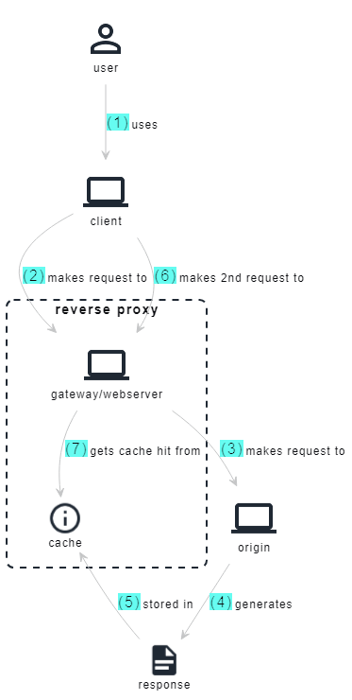
Response Caching
ASSESS
Utilize reverse proxies infront or origin servers to cache responses and serve them directly to clients
Use Cases
Useful when resources are not internet facing and have no ability to use a CDN
Frequently accessed resources
Content that is resource intensive to generate
Content where we anticipate heavy traffic spikes

Slide 10
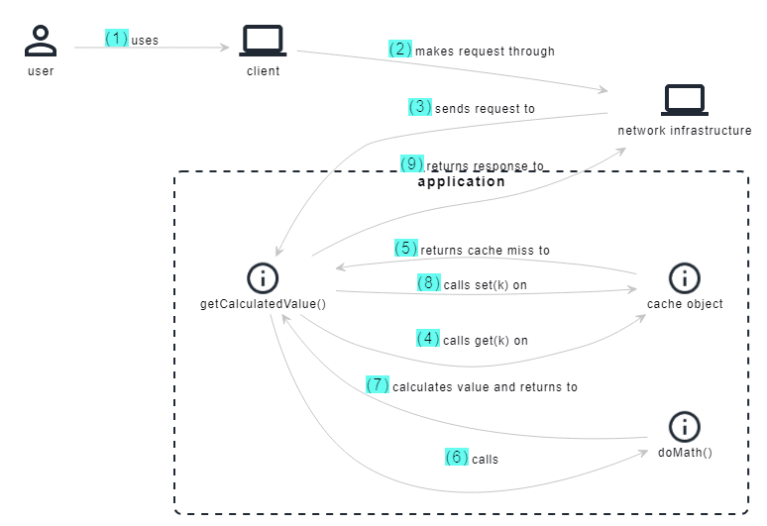
Local Application Caching
ADOPT
Implement data structures like hashmaps or libraries like Guava for Java to get fine grained control over caches per app instance
Use Cases
Scenarios where data validity and freshness need to be closely managed
Scenarios where your cache size is relatively small
Where strategy customization is required for fine grained control
When you absolutely have to have the fastest access to data.
When you don't care about each application instance having a cache data consistency
Where cache invalidation is needed by TTL only

Slide 11
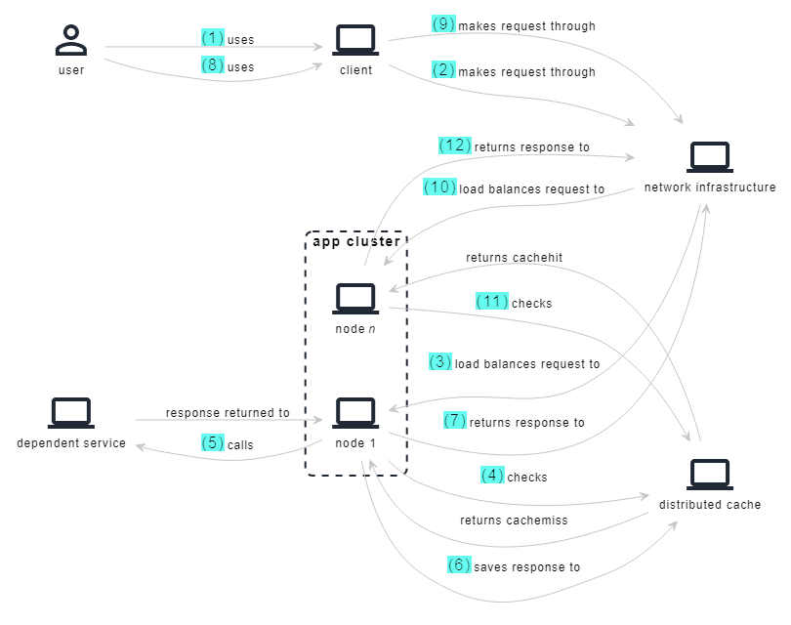
Distributed Application Caching
ADOPT
Utilize a cache externalized but close to your application instances to reduce compute or network load across your cluster
Use Cases
When you have large amounts of data to cache close to the application
When you need high availability and reliability
When you cannot afford to scale calls to dependent systems even if your application needs to scale instances.

Slide 12
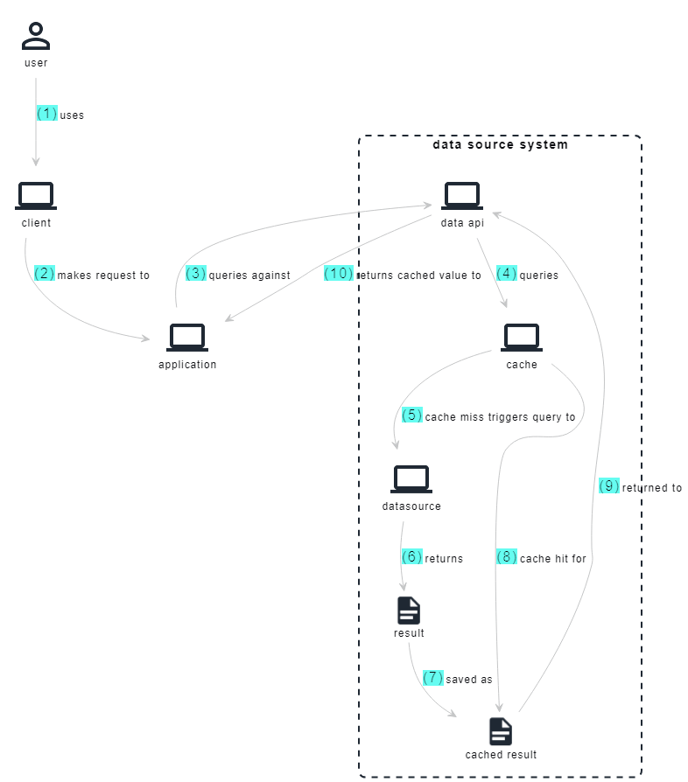
Data-Side Caching
ADOPT
Utilizes a cache alongside the persistence layer to store query results
Use Cases
Reducing the need to re-execute expensive queries
Improving response times for queries

Slide 13
You can cache stuff just about anywhere, but rarely do you need to cache in more than one place

Slide 14
The validity of your data is reduced exponentially as you introduce more points of caching for a datapoint

Slide 15
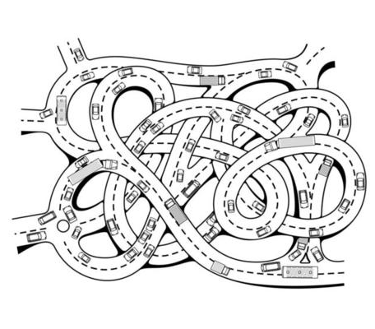
Cache Access Patterns

Slide 16
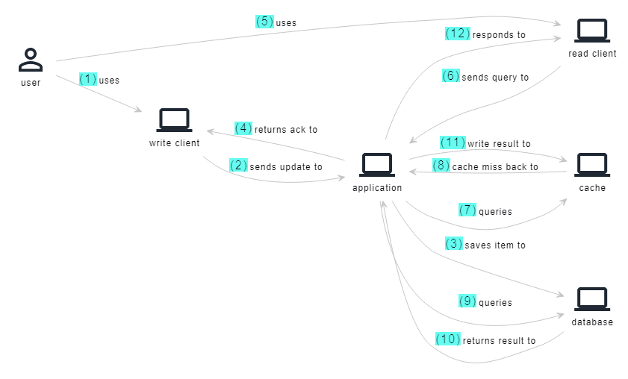
Cache Aside
ADOPT
const getItem = (itemId, source, cache) => {
let item = cache.find(itemId);
if(item == null) {
item = source.find(itemId);
cache.save(item)
}
return item;
}
const writeItem = (item, source) => {
source.save(item);
return true;
}
Best case, data is available in cache, worst case, the source must be accessed to retrieve data and write it to the cache before the read is completed

Slide 17
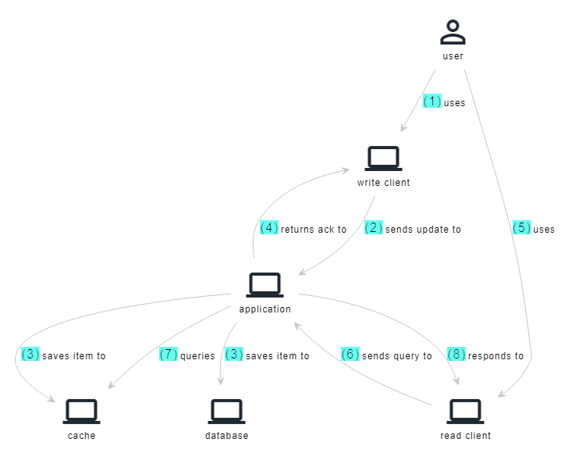
Application Write-Through
ASSESS
const getItem = (itemId, cache) => return cache.find(itemId)
const saveItem = (item, source, cache) => {
try{
cache.save(item)
source.save(item))
return true;
} catch(e) {
rollback(cache, source, item)
return false;
}
Keeps cache in sync with source, but the cache needs to fit the entire data set, and writes become slower and more complex.

Slide 18
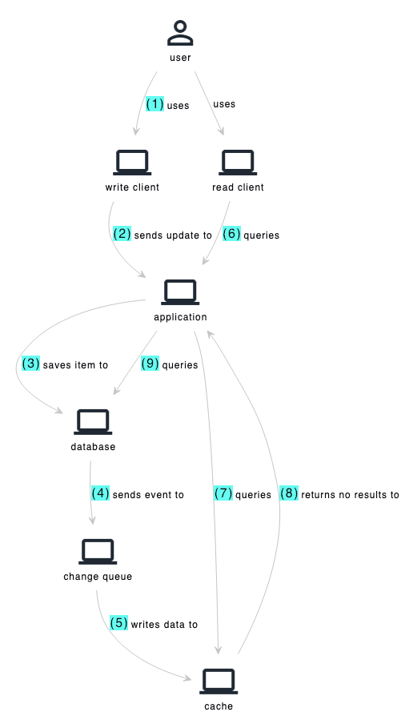
Db Write Through
ADOPT
const getItem = (itemId, cache) => return cache.find(itemId)
const saveItem = (item, source) => {
try{
source.save(item))
return true;
} catch(e) {
return false;
}
const getItem = (query, source, cache) => {
let data = source.get(query)
if(data == null){
cache.get(query)
}
return data;
}
Cache is kept eventually consistent using change data capture mechanisms attached to datasource. Applications must anticipate data not in cache scenarios

Slide 19


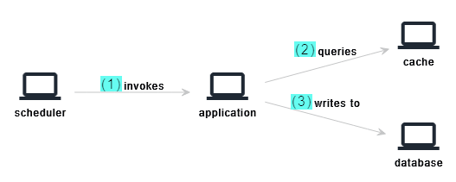
Write-Behind Batch
HOLD
writing
const getItem = (itemId, cache) => return cache.find(itemId)
const saveItem = (item, cache) => {
cache.save(item)
return true;
}
const updateSource(lastUpdatedChange, source, cache =>
{
const updatesSinceLastTime = cache.getChangesSince(lastUpdatedChange)
updatesSinceLastTime.foreach(item => {
source.save(item)
}
}
reading
making consistent
Data is first written to the cache, and then asynchronous copied over to the source to reduce load on the data source at run time

Slide 20
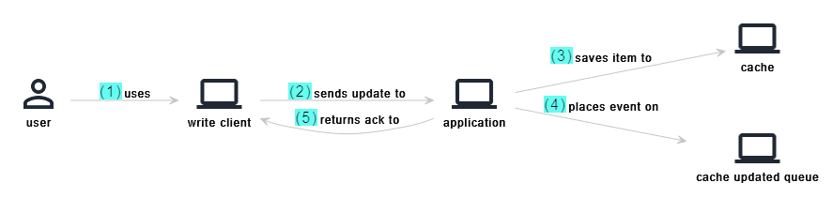
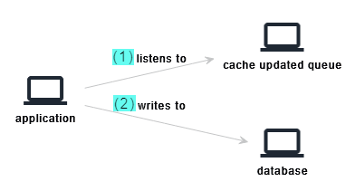
Write-Behind Events
ASSESS
writing
const getItem = (itemId, cache) => return cache.find(itemId)
const saveItem = (item, cache) => {
cache.save(item)
return true;
}
const listenForCacheChanges(queue) => {
queue.listen().then(event => {
updateSource(event);
}
}
const updateSource(event =>
{
source.save(event.body);
}
reading
making consistent
Data is first written to the cache, and then asynchronous copied over to the source to reduce load on the data source at run time

Slide 21
Cache Eviction Policies

Slide 22
Least Recently Used (LRU)
ADOPT
This eviction policy is designed to eliminate the item that has been accessed the least recently when the cache hits its capacity.
Items that have not been accessed for a longer period of time are assumed to be less likely to be used in the near future. When the cache is full, LRU evicts the item that hasn't been accessed in the longest time since it keeps track of the order in which items are accessed.
Advantages:
Efficient use of Cache
Disadvantages:
Assumes order of access reflects the future usefulness of an item
May not perform optimally after a cold start, due to requiring sufficient historical data to make informed eviction decisions.
Increases resource overhead since is requires storage and management of timestamps to maintain access order.

Slide 23
Least Frequently Used (LFU)
ADOPT
This eviction policy is designed to eliminate the item that has been accessed the least frequently when the cache hits its capacity.
It is based on the idea that things that are used the least are less likely to be needed later. When the cache is full, LFU removes the item with the lowest access frequency after keeping track of the amount of times each item is accessed.
Advantages:
Adaptability to varied access patterns where items might be access infrequently but are still essential.
Optimized for long terms trends
Low memory overhead as it only needs to maintain an access count
Disadvantages:
Sensitive to initial access while access frequencies are still being established
Can struggle when access patterns are volatile and change dramatically

Slide 24
First in First Out (FIFO)
ADOPT
First-In-First-Out (FIFO) is a cache eviction policy that removes the oldest item from the cache when it becomes full.
In this strategy, data is stored in the cache in the order it arrives, and the item that has been present in the cache for the longest time is the first to be evicted when the cache reaches its capacity.
Advantages:
Simple to implement in most cache systems
Predictable behaviour since it simply follows the insert order of a cache key
Memory efficient since it eliminates any extra tracking data
Disadvantages:
The order of entry might not reflect the importance or relevance of an item and thus can lead to inefficiencies whereby older important items are replaced by newer but less important items.

Slide 25
Random Placement
HOLD
With this policy when the cache is full and a new item needs to be stored, a randomly chosen existing item is evicted to make room.
Unlike some deterministic policies like LRU (Least Recently Used) or FIFO (First-In-First-Out), which have specific criteria for selecting items to be evicted, Random Replacement simply selects an item at random.
Advantages:
Simplicity since no tracking or analysis of access patterns is required
Avoids the biases of more deterministic policies
Low overhead makes eviction extremely performant
Disadvantages:
Suboptimal cache performance as you have no control over what gets evicted
No adaptability to changing access patterns

Slide 26
Targeted
ADOPT
With this policy and event is sent towards the cache to evict a particular cache entry or group of entries.
Determination of what is getting evicted from the cache is made by systems external to the cache, usually based on some business event.
Advantages:
Ensures cache contains no stale data
Near real-time cache consistency
Disadvantages:
Requires intentional key management
Requires more technical complexity to provide integrations into cache invalidation from external systems
No adaptability to changing access patterns

Slide 27
Caching Adds Complexity
Stale Data
For application to use caching it must accept the fact that will will serve stale data at some point.
Cache Stampede
In some cases, we might need to go back to the source to update a cache entry. We need to anticipate a situation where we get a flood of simultaneous traffic all going back to the source, and need to be careful that we don't overwhelm it.
Chattiness
Applications that use caching must acknowledge the increased cost in chattiness between the application, datasource and cache
Caching might seem simple from afar, but the devil's in the details, and you have to accept the following risks.

Slide 28
Faster and more resilient is often better but the cost to achieve it may be steep

Slide 29
The best solution is to avoid the need to cache, and just pick a datasource that meets your non-functional requirements

Slide 30
Read Only Workload Throughput
12500 QPS/Node
Read Only Workload Cost per 1K QPS/Hr
7.9 cents
SLA 99.999% Uptime
Globally Distributed
80/20 Read-Write Workload Throughput
5200 QPS/Node
80/20 Read-Write Workload
Cost per 1K QPS/Hr
19 cents
Unlimited Scaling
Strongly ACID
Spanner Might Just Be All You Need

Slide 31
...and now for something CQRS

Slide 32
Command Query Responsibility Segregation
Command:
Place an Order for a Pepperoni Pizza
Commands are about doing things and performing actions
Commands = CREATE/UPDATE/DELETE
Query:
What is the status of my Pizza Order
Queries are about getting information back about a thing
QUERIES = READ

Slide 33
The Basic Pattern
Client
Each command and query class has a corresponding handler class. Generally, Commands and Queries are dispatched to their Handler using a synchronous in-process Mediator.
Sometimes asynchronous methods, such as a Message Bus, are used for handling Commands when there are high-scale requirements.
Splitting Write and Read operations means we can optimise each side independently. This might mean different Write and Read models. It might even mean completely different databases. That choice depends on the non-functional requirements of your app.
Query
Command
Read Side
Write Side
Query
Handler
Command
Handler
Read Model
Write Model
Read Database
Write Database

Slide 34
Single Read/Write Model, Single Db
ADOPT
Client
The simplest flavor of CQRS, where commands and queries use the same models, and data is stored in the same database.
Code is cleaner, and it sets up our applications for future refactoring to more complex CQRS implementations. The big benefit is we can scale our read and write infrastructure independently to some extent.
For most things we do, this is generally a great place to start.
Query
Command
Read Side
Write Side
Query
Handler
Command
Handler
Read/Write Model
Database
Consistency: Strong
Complexity: Low
Performance/Scalability: Low

Slide 35
Differing Read/Write Models, Single Db
ADOPT
Client
Using different Read and Write Models allows us to optimise each side slightly differently, generally for performance on the read side, and data consistency on the write side.
Our options on either side are fairly limited in how far our optimizations can go since we use the same database for Commands and Queries.
Query
Command
Read Side
Write Side
Query
Handler
Command
Handler
Read Model
Write Model
Database
Consistency: Strong
Complexity: Low/Medium
Performance/Scalability: Medium

Slide 36
Differing Read/Write Dbs
ADOPT
Client
Using different databases for Read and Write means we can use a Polyglot Architecture, where we pick a database that perfectly fits the problem on each side.
Since different databases are being used we cannot commit things in a single ACID transaction, and so we generally fall back to asynchronous events to provide eventual consistency between data sources
Query
Command
Read Side
Write Side
Query
Handler
Command
Handler
Read Model
Write Model
Read Database
Event
Write Database
Consistency: Eventual Consistency
Complexity: High
Performance/Scalability: High

Slide 37
Event Sourcing, Differing Dbs
ASSESS
Client
When using different databases, and relying on events to sync the two, the order of event processing from the write to read side starts to become very important.
With event sourcing, instead of storing the current state of a model, append only event streams are used to record the full series of actions taken on a model instance. When a new command occurs, the current state of the model is rehydrated by replaying all the historical events
Query
Command
Read Side
Write Side
Query
Handler
Command
Handler
Read Model
Event Stream
Read Database
Event
Write Database
Consistency: Eventual Consistency
Complexity: High
Performance/Scalability: High

Slide 38
Event Sourcing, Single Db
ASSESS
Client
If we don't have massive scaling requirements, we can trim down the complexity of the event sourcing patterns, by using a single database. By doing so we eliminate all of our data consistency concerns by committing against read and write models in a single transaction.
Despite our ability to scale as well as in the multidatabase example, we still maintain all the benefits of event sourcing, like on demand rehydration, extensibility to support new new read models etc.
Query
Command
Read Side
Write Side
Query
Handler
Command
Handler
Read Model
Event Stream
Consistency: Strong
Complexity: Medium
Performance/Scalability: Medium
Database

